Slide 1
DISTRIBUTED SYSTEM MODELS AND ENABLING TECHNOLOGIES
P. Krishna Reddy, IIIT Hyderabad
Reference: Chapter 1 of the following book
“Distributed and Cloud Computing: From Parallel Processing to the Internet of Things”
by Kai Hwang, Jack Dongarra, Geoffrey C. Fox, Elseiver

Slide 2
About this lecture
Discuss the evolutionary changes that have occurred over the past 30 years, driven by applications with variable workloads and large data sets
parallel,
distributed, and
cloud computing
We study both high-performance and high throughput computing systems in parallel computers appearing as
computer clusters,
service- oriented architecture,
computational grids,
peer-to-peer networks,
Internet clouds, and
the Internet of Things.
These systems are distinguished by their
hardware architectures,
OS platforms,
processing algorithms,
communication protocols, and
service models.
Introduce the following essential issues in distributed systems
scalability,
performance,
availability,
security, and
energy efficiency

Slide 3
Outline
Scalable Computing over the Internet
Technologies for Network Based Systems
System Models for Distributed and Cloud Computing
Software Environments for Distributed Systems and Clouds. .
Performance, Security, and Energy Efficiency

Slide 4
SCALABLE COMPUTING OVER THE INTERNET
Over the past 60 years, computing technology has undergone a series of platform and environment changes.
Evolutionary changes have occurred in
machine architecture,
operating system platform,
network connectivity, and
application workload.
Instead of using a centralized computer to solve computational problems, a parallel and distributed computing system uses multiple computers to solve large-scale problems over the Internet.
Distributed computing becomes data-intensive and network-centric.
We discuss the applications of modern computer systems that practice parallel and distributed computing.
These large-scale Internet applications have significantly enhanced the quality of life and information services in society today.

Slide 5
About Scalable Computing
Scalability is the ability of a system, network, or process to handle a growing amount of work in a capable manner or its ability to be enlarged to accommodate that growth.
For example, it can refer to the capability of a system to increase its total output under an increased load when resources (typically hardware) are added.
Billions of people use the Internet every day.
As a result, supercomputer sites and large data centers must provide high-performance computing services to huge numbers of Internet users concurrently
Because of this high demand, high-performance computing (HPC) applications is no longer optimal for measuring system performance.
The emergence of computing clouds instead demands high-throughput computing (HTC) systems built with parallel and distributed computing technologies.

Slide 6
Some || Terminology
Ideal
Xact/sec.
(throughput)
Speed-Up
More resources means proportionally less time for given amount of data.
Scale-Up
If resources increased in proportion to increase in data size, time is constant.
degree of ||-ism
Ideal
sec./Xact
(response time)
degree of ||-ism

Slide 7
Internet Computing and Platform Evolution
Internet computing
It is the foundation on which ebusiness runs.
It is the only architecture that can run all facets of business, from supplier collaboration and merchandise purchasing, to distribution and store operations, to customer sales and service
The Platform Evolution : five generations of development,
From 1950 to 1970, a handful of mainframes, including the IBM 360 and CDC 6400, were built to satisfy the demands of large businesses and government organizations.
From 1960 to 1980, lower-cost minicomputers such as the DEC PDP 11 and VAX Series became popular among small businesses and on college campuses.
From 1970 to 1990, we saw widespread use of personal computers built with VLSI microprocessors.
From 1980 to 2000, massive numbers of portable computers and pervasive devices appeared in both wired and wireless applications.

Slide 8
Evolution of HPC and HTC systems
High performance computing (HPC)
On the HPC side, supercomputers (massively parallel processors or MPPs) are gradually replaced by clusters of cooperative computers out of a desire to share computing resources.
The cluster is often a collection of homogeneous compute nodes that are physically connected in close range to one another.
High throughput computing (HTC)
Peer-to-peer (P2P) networks are formed for distributed file sharing and content delivery applications.
A P2P system is built over many client machines. Peer machines are globally distributed in nature.
P2P, cloud computing, and web service platforms are more focused on HTC applications than on HPC applications.
Clustering and P2P technologies lead to the development of
computational grids or data grids.

Slide 9
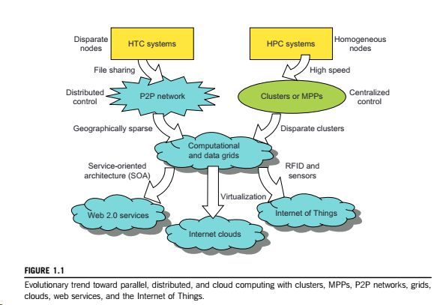

Slide 10
More about HPC and HTC
HPC:
For many years, HPC systems emphasize the raw speed performance.
The speed of HPC systems has increased from Gflops in the early 1990s to now Pflops in 2010.
This improvement was driven mainly by the demands from scientific, engineering, and manufacturing communities.
For example the Top 500 most powerful computer systems in the world are measured by floating-point speed in Linpack benchmark results.
However, the number of supercomputer users is limited to less than 10% of all computer users. Today, the majority of computer users are using desktop computers or large servers when they conduct Internet searches and market-driven computing tasks.
HTC
This HTC paradigm pays more attention to high-flux computing.
The main application is in Internet searches and web services by millions or more users simultaneously.
The performance goal thus shifts to measure high throughput or the number of tasks completed per unit of time.
HTC technology needs to not only improve in terms of batch processing speed, but also address the acute problems of
cost, energy savings, security, and reliability at many data and enterprise computing centers.

Slide 11
New Computing Paradigms
When the Internet was introduced in 1969, Leonard Klienrock of UCLA declared:
“As of now, computer networks are still in their infancy, but as they grow up and become sophisticated, we will probably see the spread of computer utilities, which like present electric and telephone utilities, will service individual homes and offices across the country.”
In 1984, John Gage of Sun Microsystems created the slogan,
“The network is the computer.”
In 2008, David Patterson of UC Berkeley said,
“The data center is the computer. “
There are dramatic differences between developing software for millions to use as a service versus distributing software to run on their PCs.”
Recently, Rajkumar Buyya of Melbourne University simply said:
“The cloud is the computer.”

Slide 12
Computing Paradigm Distinctions
Centralized Computing: This is a computing paradigm by which all computer resources are centralized in one physical system.
All resources (processors, memory, and storage) are fully shared and tightly coupled within one integrated OS. Many data centers and supercomputers are centralized systems, but they are used in parallel, distributed, and cloud computing applications.
Parallel computing: In parallel computing, all processors are either tightly coupled with centralized shared memory or loosely coupled with distributed memory. Interprocessor communication is accomplished through shared memory or via message passing.
Distributed computing: A distributed system consists of multiple autonomous computers, each having its own private memory, communicating through a computer network. Information exchange in a distributed system is accomplished through message passing.
Cloud computing: An Internet cloud of resources can be either a centralized or a distributed computing system. The cloud applies parallel or distributed computing, or both. Clouds can be built with physical or virtualized resources over large data centers that are centralized or distributed.
Some authors consider cloud computing to be a form of utility computing or service computing

Slide 13
More about HPC and HTC systems
Meeting these goals requires to yield the following design objectives:
Efficiency measures the utilization rate of resources in an execution model by exploiting massive parallelism in HPC.
For HTC, efficiency is more closely related to job throughput, data access, storage, and power efficiency.
Dependability measures the reliability and self-management from the chip to the system and application levels. The purpose is to provide high-throughput service with Quality of Service (QoS) assurance, even under failure conditions.
Adaptation in the programming model measures the ability to support billions of job requests over massive data sets and virtualized cloud resources under various workload and service models.
Flexibility in application deployment measures the ability of distributed systems to run well in both HPC (science and engineering) and HTC (business) applications.
Both HPC and HTC systems
will demand multicore or many-core processors
Emphasize parallelism and distributed computing.
satisfy this huge demand in computing power in terms of throughput, efficiency, scalability, and reliability.
The system efficiency is decided by speed, programming, and energy factors (i.e., throughput per watt of energy consumed).

Slide 14
Scalable Computing Trends and New Paradigms: Degrees of parallelism
Instruction-level parallelism (ILP), in which the processor executes multiple instructions simultaneously rather than only one instruction at a time.
For the past 30 years, we have practiced ILP through pipelining, superscalar computing, VLIW (very long instruction word) architectures, and multithreading.
ILP requires branch prediction, dynamic scheduling, speculation, and compiler support to work efficiently.
Data-level parallelism (DLP) was made popular through SIMD (single instruction, multiple data) and vector machines using vector or array types of instructions.
DLP requires even more hardware support and compiler assistance to work properly.
Ever since the introduction of multicore processors and chip multiprocessors (CMPs), we have been exploring task-level parallelism (TLP).
A modern processor explores all of the aforementioned parallelism types.
In fact, BLP, ILP, and DLP are well supported by advances in hardware and compilers.
However, TLP is far from being very successful due to difficulty in programming and compilation of code for efficient execution on multicore CMPs.
As we move from parallel processing to distributed processing, we will see an increase in computing granularity to job-level parallelism (JLP).

Slide 15
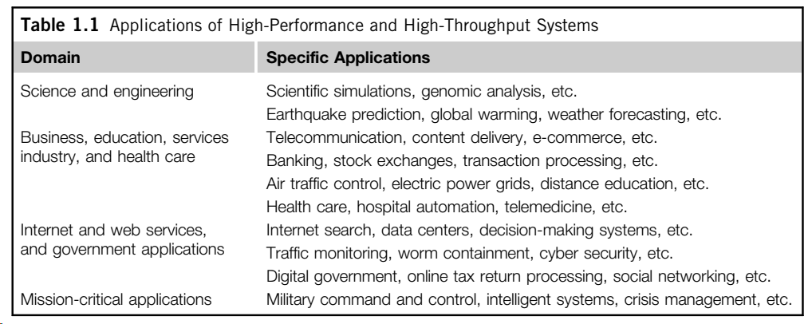
Innovative Applications
Both HPC and HTC systems desire transparency in many application aspects.
For example, data access, resource allocation, process location, concurrency in execution, job replication, and failure recovery should be made transparent to both users and system management.

Slide 16
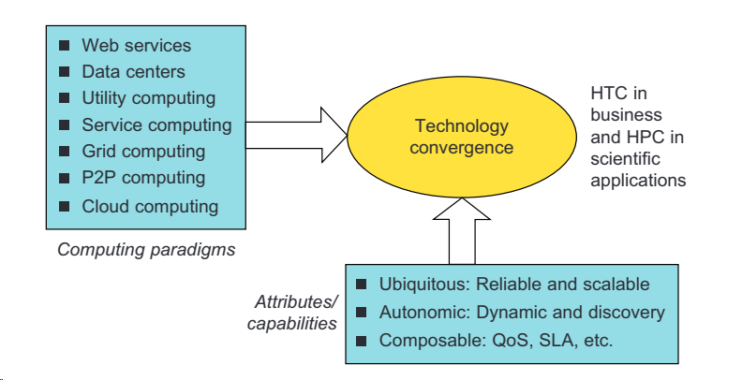
The Trend toward Utility Computing
Utility computing focuses on a business model in which customers receive computing resources from a paid service provider. All grid/cloud platforms are regarded as utility service providers.

Slide 17
The Internet of Things
The IoT refers to the networked interconnection of everyday objects, tools, devices, or computers. One can view the IoT as a wireless network of sensors that interconnect all things in our daily life.
The IoT needs to be designed to track 100 trillion static or moving objects simultaneously.
The IoT demands universal addressability of all of the objects or things. To reduce the complexity of identification, search, and storage, one can set the threshold to filter out fine-grain objects.

Slide 18
Cyber-Physical Systems
A cyber-physical system (CPS) is the result of interaction between computational processes and the physical world.
A CPS integrates “cyber” (heterogeneous, asynchronous) with “physical” (concurrent and information- dense) objects.
A CPS merges the “3C” technologies of computation, communication, and control into an intelligent closed feedback system between the physical world and the information world.
The IoT emphasizes various networking connections among physical objects, while the CPS emphasizes exploration of virtual reality (VR) applications in the physical world

Slide 19
Outline
Scalable Computing over the Internet
Technologies for Network Based Systems
System Models for Distributed and Cloud Computing
Software Environments for Distributed Systems and Clouds. .
Performance, Security, and Energy Efficiency

Slide 20
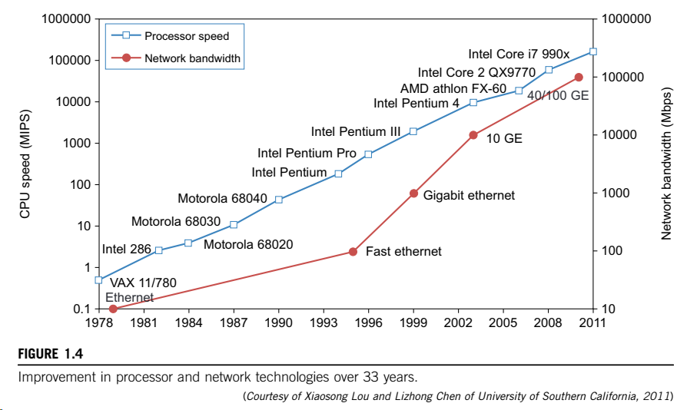

Slide 21
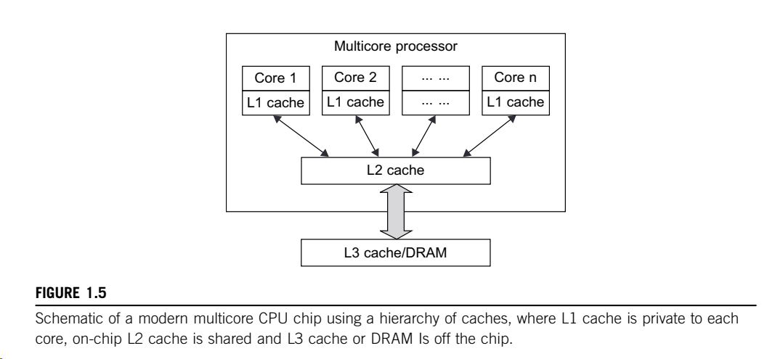
Multi core CPUs and Multithreading Technologies: Advances in CPU Processors:
Today, advanced CPUs or microprocessor chips assume a multi core architecture with dual, quad, six, or more processing cores. These processors exploit parallelism at ILP and TLP levels.
Both multi-core CPU and many-core GPU processors can handle multiple instruction threads at different magnitudes today. Figure 1.5 shows the architecture of a typical multicore processor. Each core is essentially a processor with its own private cache (L1 cache). Multiple cores are housed in the same chip with an L2 cache that is shared by all cores

Slide 22
Multicore CPU and Many-Core GPU Architectures:
Multicore CPUs may increase from the tens of cores to hundreds or more in the future.
But the CPU has reached its limit in terms of exploiting massive DLP due to the memory wall problem.
This has triggered the development of many-core GPUs with hundreds or more thin cores.

Slide 23
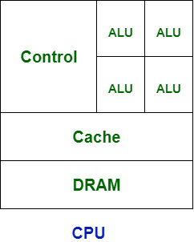
Central Processing Unit (CPU)
CPU is known as brain for every ingrained system.
CPU comprises the arithmetic logic unit (ALU) accustomed quickly to store the information and perform calculations and Control Unit (CU) for performing instruction sequencing as well as branching.
CPU interacts with more computer components such as memory, input and output for performing instruction.

Slide 24
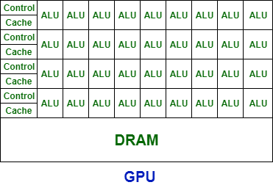
Graphics Processing Unit (GPU)
GPU is used to provide the images in computer games.
GPU is faster than CPU’s speed and it emphasis on high throughput.
It’s generally incorporated with electronic equipment for sharing RAM with electronic equipment that is nice for the foremost computing task.
It contains more ALU units than CPU.
SIMD

Slide 25
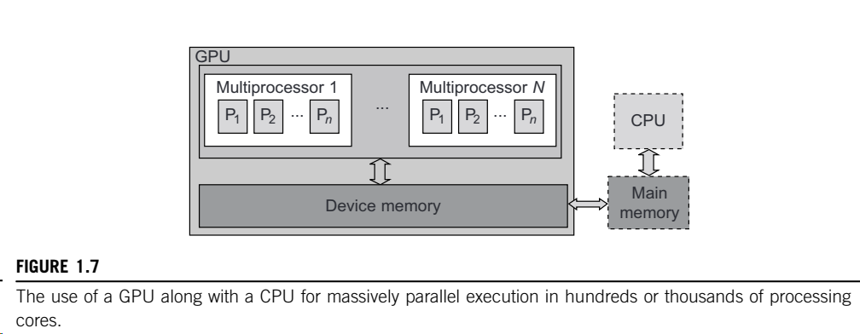
GPU Programming Model
The interaction between a CPU and GPU in performing parallel execution of floating-point operations concurrently. The CPU is the conventional multicore processor with limited parallelism to exploit.
The GPU has a many-core architecture that has hundreds of simple processing cores organized as multiprocessors. Each core can have one or more threads.
Essentially, the CPU’s floating- point kernel computation role is largely offloaded to the many-core GPU.
The CPU instructs the GPU to perform massive data processing. The bandwidth must be matched between the on-board main memory and the on-chip GPU memory.

Slide 26
Memory, Storage, and Wide-Area Networking

Slide 27
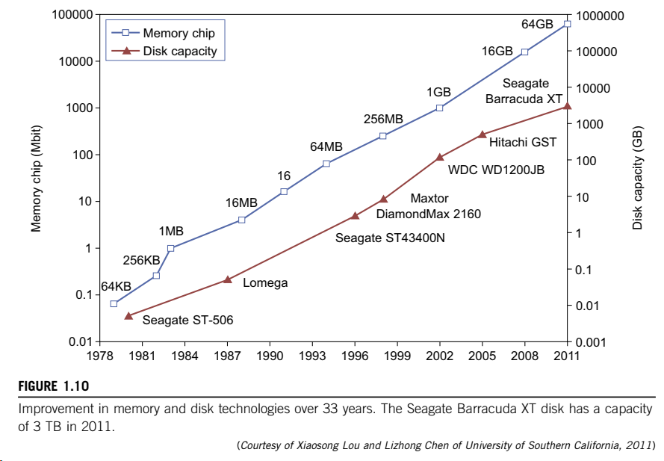

Slide 28
System-Area Interconnects
Local area network (LAN) is used to connect client hosts to big servers
Storage Area Network (SAN) connects servers to network storage such as disk arrays.
Network attached storage (NAS) connects client hosts directly to the disk arrays.
All types of network appear in a large cluster.

Slide 29
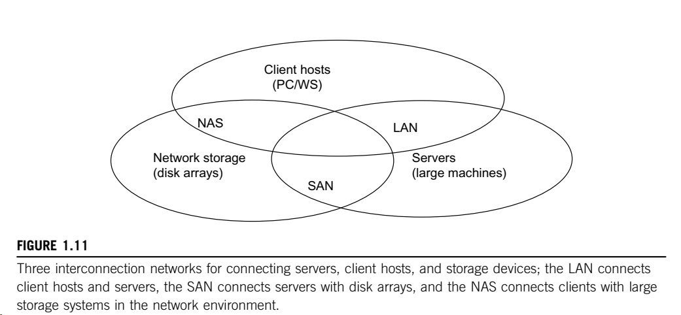
System Area Interconnects

Slide 30
Virtual Machines and Virtualization Middleware
A conventional computer has a single OS image. This offers a rigid architecture that tightly couples application software to a specific hardware platform.
Some software running well on one machine may not be executable on another platform with a different instruction set under a fixed OS.
Virtual machines
The VM can be provisioned for any hardware system. The VM is built with virtual resources managed by a guest OS to run a specific application. Between the VMs and the host platform, one needs to deploy a middleware layer called a virtual machine monitor (VMM).
The guest OS could be a Linux system and the hypervisor is the XEN system developed at Cambridge University. This hypervisor approach is also called bare- metal VM, because the hypervisor handles the bare hardware (CPU, memory, and I/O) directly.
The VMM provides the VM abstraction to the guest OS.
With full virtualization, the VMM exports a VM abstraction identical to the physical machine so that a standard OS such as Windows 2000 or Linux can run just as it would on the physical hardware.

Slide 31
Virtual Machines Operations
First, the VMs can be multiplexed between hardware machines, as shown in Figure 1.13(a).
Second, a VM can be suspended and stored in stable storage, as shown in Figure 1.13(b).
Third, a suspended VM can be resumed or provisioned to a new hardware platform, as shown in Figure 1.13(c).
Finally, a VM can be migrated from one hardware platform to another, as shown in Figure 1.13(d).
These VM operations enable a VM to be provisioned to any available hardware platform.
They also enable flexibility in porting distributed application executions.
Furthermore, the VM approach will significantly enhance the utilization of server resources.
Multiple server functions can be consolidated on the same hardware platform to achieve higher system efficiency.
This will eliminate server sprawl via deployment of systems as VMs, which move transparency to the shared hardware.
With this approach, VMware claimed that server utilization could be increased from its current5–15 percent to 60–80 percent.

Slide 32
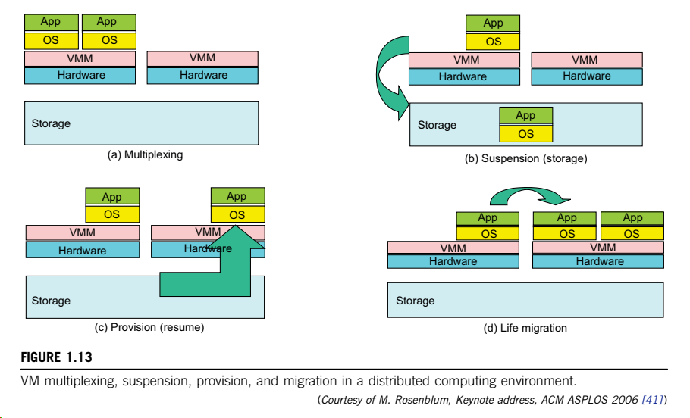

Slide 33
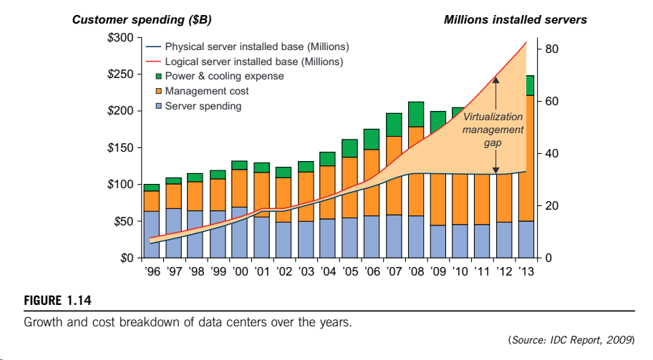

Slide 34
Virtual Infrastructure
Almost all cloud platforms choose the popular x86 processors. Low-cost terabyte disks and Gigabit Ethernet are used to build data centers.
A large data center may be built with thousands of servers. Smaller data centers are typically built with hundreds of servers.
Low cost design philosophy
High-end switches or routers may be too cost- prohibitive for building data centers. Thus, using high- bandwidth networks may not fit the economics of cloud computing.
Recent advances in SOA, Web 2.0, and mashups of platforms are pushing the cloud another step forward.
Finally, achievements in autonomic computing and automated data center operations contribute to the rise of cloud computing.

Slide 35
Summary
Achievements in autonomic computing and automated data center operations contribute to the rise of cloud computing.
A cycle of interaction exists among four technical areas.
First, cloud technology is driven by a surge of interest in data deluge.
Also, cloud computing impacts e-science greatly, which explores multicore and parallel computing technologies. These two hot areas enable the buildup of data deluge. To support data intensive computing, one needs to address workflows, databases, algorithms, and virtualization issues.
By linking computer science and technologies with scientists, a spectrum of e-science or e-research applications in biology, chemistry, physics, the social sciences, and the humanities has generated new insights from interdisciplinary activities.
Cloud computing is a transformative approach as it promises much more than a data center model.
It fundamentally changes how we interact with information.
At the platform level, MapReduce offers a new programming model that transparently handles data parallelism with natural fault tolerance capability.
They enable the pipeline: Data becomes information and knowledge, and in turn becomes machine wisdom as desired in SOA.

Slide 36
Outline
Scalable Computing over the Internet
Technologies for Network Based Systems
System Models for Distributed and Cloud Computing
Software Environments for Distributed Systems and Clouds. .
Performance, Security, and Energy Efficiency

Slide 37
About System Models
Distributed and cloud computing systems are built over a large number of autonomous computer nodes.
These node machines are interconnected by SANs, LANs, or WANs in a hierarchical manner.
With today’s networking technology, a few LAN switches can easily connect hundreds of machines as a working cluster.
A WAN can connect many local clusters to form a very large cluster of clusters.
Massive systems are considered highly scalable, and can reach web-scale connectivity, either physically or logically.
In Table 1.2, massive systems are classified into four groups: clusters, P2P, networks, computing grids, and Internet clouds over huge data centers.
In terms of node number, these four system classes may involve hundreds, thousands, or even millions of computers as participating nodes.
These machines work collectively, cooperatively, or collaboratively at various levels. The table entries characterize these four system classes in various technical and application aspects

Slide 38
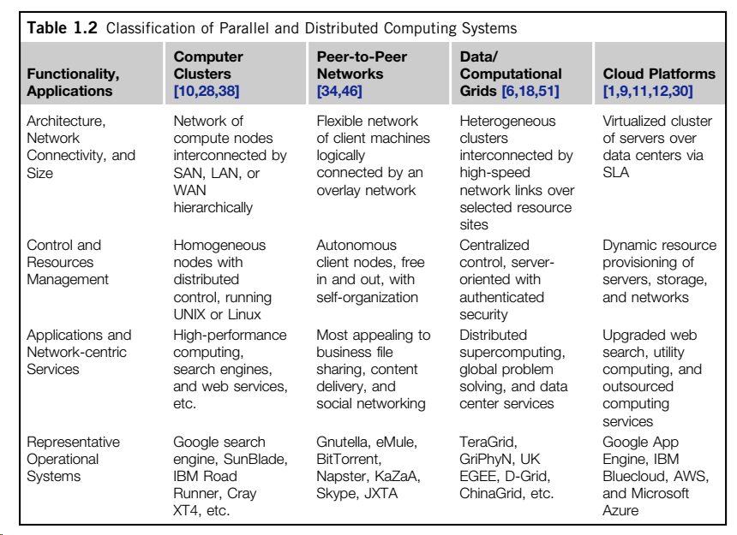

Slide 39
Clusters of Cooperative Computers: Cluster Architecture
Typical server cluster built around a low-latency, high bandwidth interconnection network.
This network can be as simple as a SAN (e.g., Myrinet) or a LAN (e.g., Ethernet).
To build a larger cluster with more nodes, the interconnection network can be built with multiple levels of Gigabit Ethernet, Myrinet, or InfiniBand switches.
Through hierarchical construction using a SAN, LAN, or WAN, one can build scalable clusters with an increasing number of nodes.
The cluster is connected to the Internet via a virtual private network (VPN) gateway.
The gateway IP address locates the cluster. The system image of a computer is decided by the way the OS manages the shared cluster resources.
Most clusters have loosely coupled node computers. All resources of a server node are managed by their own OS. Thus, most clusters have multiple system images as a result of having many autonomous nodes under different OS control

Slide 40
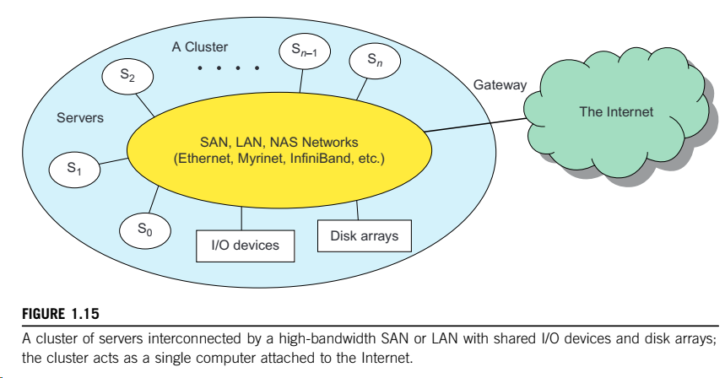

Slide 41
Single-System Image
An Single System Image (SSI) is an illusion created by software or hardware that presents a collection of resources as one integrated, powerful resource.
SSI makes the cluster appear like a single machine to the user.
A cluster with multiple system images is nothing but a collection of independent computers.

Slide 42
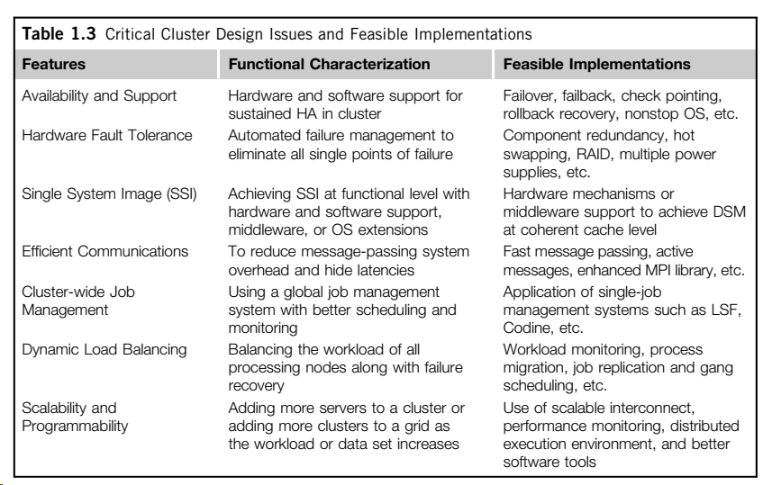
Major Cluster Design Issues

Slide 43
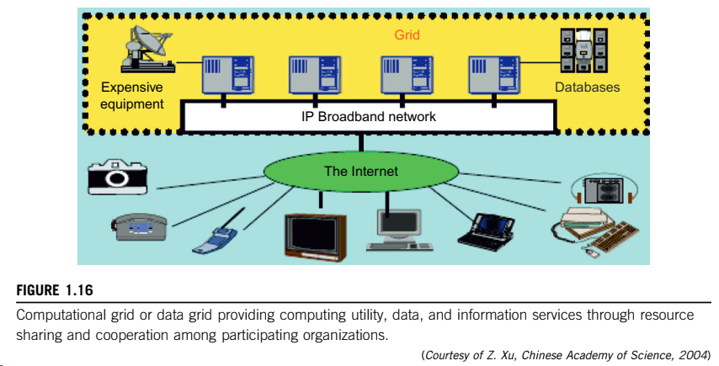
Grid Computing Infrastructures: Computational Grids
Like an electric utility power grid, a computing grid offers an infrastructure that couples computers, software/middleware, special instruments, and people and sensors together.
The grid is often constructed across LAN, WAN, or Internet backbone networks
The computers used in a grid are primarily workstations, servers, clusters, and supercomputers.
Personal computers, laptops, and PDAs can be used as access devices to a grid system

Slide 44
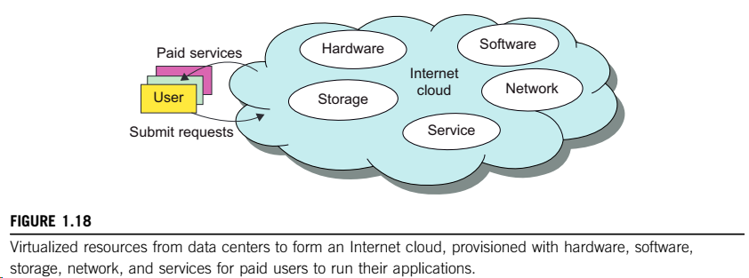
Cloud Computing Over Internet
IBM, a major player in cloud computing, has defined it as follows: “A cloud is a pool of virtualized computer resources. A cloud can host a variety of different workloads, including batch-style backend jobs and interactive and user-facing applications.”
Based on this definition, a cloud allows workloads to be deployed and scaled out quickly through rapid provisioning of virtual or physical machines.
The cloud supports redundant, self-recovering, highly scalable programming models that allow workloads to recover from many unavoidable hardware/software failures.
Finally, the cloud system should be able to monitor resource use in real time to enable rebalancing of allocations when needed

Slide 45
The Cloud Landscape
Traditionally, a distributed computing system tends to be owned and operated by an autonomous administrative domain (e.g., a research laboratory or company) for on-premises computing needs.
performance bottlenecks: constant system maintenance, poor utilization, and increasing costs associated with hardware/software upgrades.
Cloud computing as an on-demand computing paradigm resolves or relieves us from these problems.

Slide 46
Cloud Service models
Infrastructure as a Service (IaaS)
This model puts together infrastructures demanded by users—namely servers, storage, networks, and the data center fabric.
The user can deploy and run on multiple VMs running guest OSes on specific applications.
The user does not manage or control the underlying cloud infrastructure, but can specify when to request and release the needed resources.
Platform as a Service (PaaS)
This model enables the user to deploy user-built applications onto a virtualized cloud platform. PaaS includes middleware, databases, development tools, and some runtime support such as Web 2.0 and Java.
The platform includes both hardware and software integrated with specific programming interfaces.
The provider supplies the API and software tools (e.g., Java, Python, Web 2.0, .NET). The user is freed from managing the cloud infrastructure.
Software as a Service (SaaS)
This refers to browser-initiated application software over thousands of paid cloud customers.
The SaaS model applies to business processes, industry applications, consumer relationship management (CRM), enterprise resources planning (ERP), human resources (HR), and collaborative applications.
On the customer side, there is no upfront investment in servers or software licensing. On the provider side, costs are rather low, compared with conventional hosting of user applications.

Slide 47
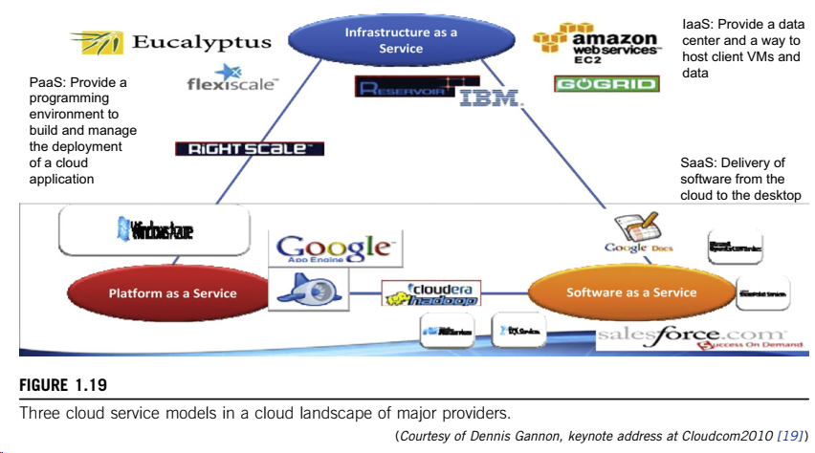

Slide 48
Reasons for the Adoption of Cloud Computing
Desired location in areas with protected space and higher energy efficiency
Sharing of peak-load capacity among a large pool of users, improving overall utilization
Separation of infrastructure maintenance duties from domain-specific application development
Significant reduction in cloud computing cost, compared with traditional computing paradigms
Cloud computing programming and application development
Service and data discovery and content/service distribution
Privacy, security, copyright, and reliability issues
Service agreements, business models, and pricing policies

Slide 49
Outline
Scalable Computing over the Internet
Technologies for Network Based Systems
System Models for Distributed and Cloud Computing
Software Environments for Distributed Systems and Clouds.
Performance, Security, and Energy Efficiency

Slide 50
Trends toward Distributed Operating Systems
The computers in most distributed systems are loosely coupled.
a distributed system inherently has multiple system images.
Because all node machines run with an independent operating system.
To promote resource sharing and fast communication among node machines, it is best to have a distributed OS that manages all resources coherently and efficiently.
Such a system is most likely to be a closed system, and it will likely rely on message passing and RPCs for internode communications.
A distributed OS is crucial for upgrading the performance, efficiency, and flexibility of distributed applications.

Slide 51
Distributed Operating Systems
Three approaches
First: Build a network OS on the top of network of heterogeneus computers.
Low transparency to users
It is essentially a distributed file system
Second: Develop a middleware for resource sharing
Third: Develop a truly distributed OS for higher system transparency.
Goal of Amoeba project
To construct an operating system for networks of computers that would present the network to the user as if it were a single machine.
DCE is the middleware system for distributed computing
.
MOSIX2 is a distributed OS
runs with a virtualization layer in the Linux environment.
This layer provides a partial single-system image to user applications.
supports both sequential and parallel applications, and discovers resources and migrates software processes among Linux nodes.
manages a Linux cluster or a grid of multiple clusters.
Flexible management of a grid allows owners of clusters to share their computational resources among multiple cluster owners.
A MOSIX-enabled grid can extend indefinitely as long as trust exists among the cluster owners.
The MOSIX2 is being explored for managing resources in all sorts of clusters, including Linux clusters,GPU clusters, grids, and even clouds if VMs are used.

Slide 52
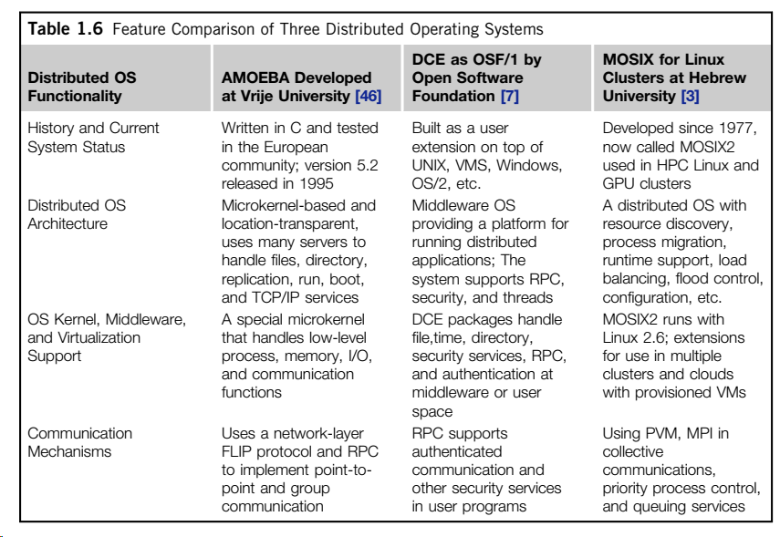

Slide 53
Parallel and Distributed Programming Models
MPI
Library of programs that can be called from C or FORTRAN to write parallel programs running on a distributed system
MapReduce
Programming model for scalable data processing on clusters of machines on large datasets.
Hadoop library
It is a package which enables users to write and run over vast amounts of distributed data
Scale to store and process petabytes of data

Slide 54
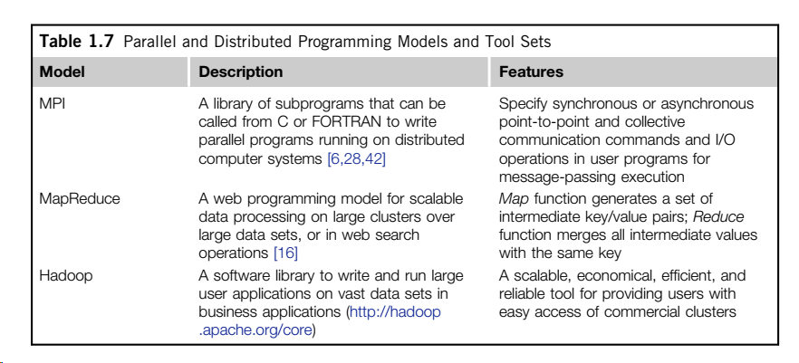

Slide 55
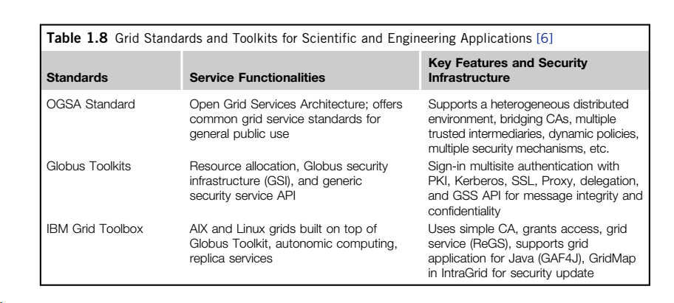
GRID Standards
Open Grid Services Architecture (OGSA) :
The development of grid infrastructure is driven by large-scale distributed computing applications.
CA: Certificate authority
PKI: Public Key Infrastructure

Slide 56
Outline
Scalable Computing over the Internet
Technologies for Network Based Systems
System Models for Distributed and Cloud Computing
Software Environments for Distributed Systems and Clouds.
Performance, Security, and Energy Efficiency

Slide 57
Performance: Metrics
In a distributed system, performance is attributed to a large number of factors.
System throughput is often measured in MIPS, Tflops (tera floating-point operations per second), or TPS (transactions per second).
Job response time and network latency.
An interconnection network that has low latency and high bandwidth is preferred.
System overhead is often attributed to OS boot time, compile time, I/O data rate.
Other performance-related metrics include
the QoS for Internet and web services; system availability and dependability; and security resilience for system defense against network attacks.

Slide 58
Dimensions of Scalability
Size scalability
This refers to achieving higher performance or more functionality by increasing the machine size.
Software scalability
This refers to upgrades in the OS or compilers, adding mathematical and engineering libraries, porting new application software, and installing more user-friendly programming environments.
Application scalability
This refers to matching problem size scalability with machine size scalability. Problem size affects the size of the data set or the workload increase.
Technology scalability
This refers to a system that can adapt to changes in building technologies, such as the component and networking technologies.

Slide 59
Amdhal’s law
T= execution time in uniprocessor workstation
α fraction of code is executed sequentially, n: number of processors
Amdahl’s Law states that the speedup factor of using the n-processor system over the use of a single processor is expressed by:
The maximum speed up of n is achieved only if the sequential bottleneck α is reduced to zero or the code is fully parallelizable with α = 0.
As t n → ∞, S approaches 1/α, an upper bound on the speedup S.
Surprisingly, this upper bound is independent of the cluster size n. The sequential bottleneck is the portion of the code that cannot be parallelized.
For example, the maximum speedup achieved is 4, if α = 0.25 or 1 − α = 0.75, even if one uses hundreds of processors.
We should make the sequential bottleneck as small as possible.
Increasing the cluster size alone may not result in a good speedup

Slide 60
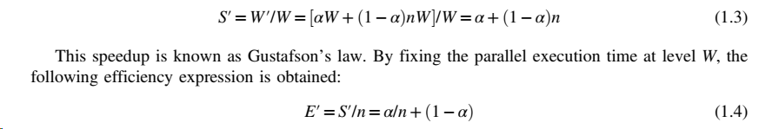
Problem with fixed workload
Gustafson’s Law
To achieve higher efficiency when using a large cluster, we must consider scaling the problem size to match the cluster capability. This leads to the following speedup law proposed by John Gustafson (1988), referred as scaled- workload speedup in.
Let W be the workload in a given program. When using an n-processor system, the user scales the workload to W′ = αW+ (1 − α)nW.
Note that only the parallelizable portion of the workload is scaled n times in the second term. This scaled workload W′ is essentially the sequential execution time on a single processor.
The parallel execution time of a scaled workload W′ on n processors is defined by a scaled-workload speedup as follows:

Slide 61
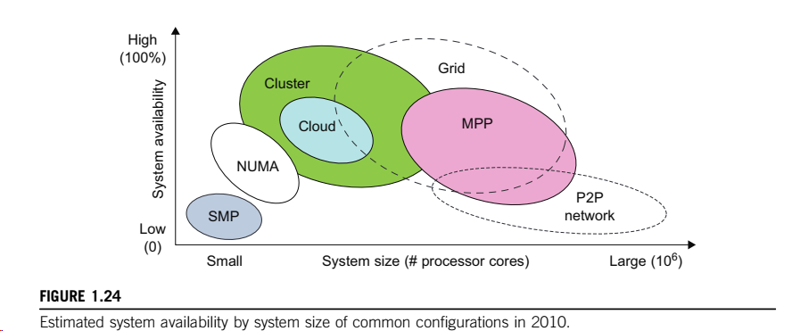
Fault Tolerance and System Availability
HA (high availability) is desired in all clusters, grids, P2P networks, and cloud systems.
A system is highly available if it has a long mean time to failure (MTTF) and a short mean time to repair (MTTR).
System availability is formally defined as follows: MTTF/(MTTF+MTTR)

Slide 62
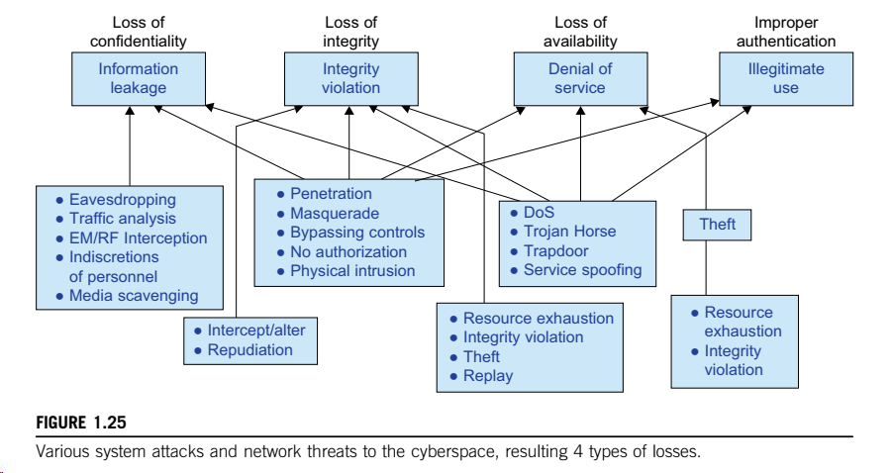
Network Threats and Data Integrity

Slide 63
Energy Efficiency in Distributed Computing
Primary performance goals in conventional parallel and distributed computing systems are high performance and high throughput, considering some form of performance reliability (e.g., fault tolerance and security).
Protection of data centers demands integrated solutions.
Energy consumption in parallel and distributed computing systems raises various monetary, environmental, and system performance issues.
Cooling is another cost

Slide 64
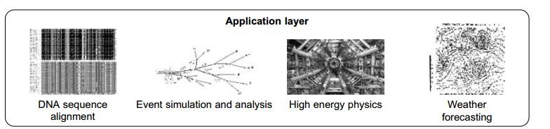
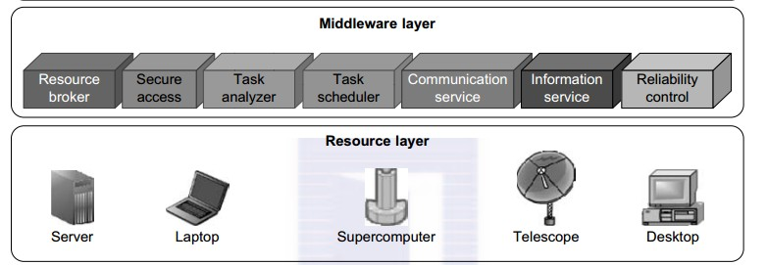

Slide 65
Energy Consumption in Unused Servers
Significant savings by switching of unused servers.
In the past one sixth of servers are powered on without being used.

Slide 66
Reduce energy in active servers
Application layer
Proportional to number of instructions executed
Number of transactions with main memory
Middleware layer
Efficient scheduling to reduce task execution time and energy consumption
Resource layer
Switching power models, switching different frequencies
Network layer
Energy efficient routing algorithms

Slide 67

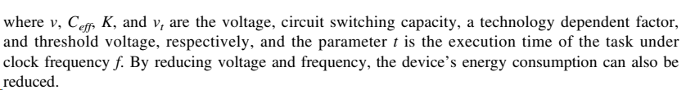
DVFS method for Energy Efficiency
Dynamic voltage and frequency scaling (DVFS) is a technique that aims at reducing the dynamic power consumption by dynamically adjusting voltage and frequency of a CPU
The relationship between energy and voltage frequency in CMOS circuits is related by:

Slide 68
Summary
Scalable Computing over the Internet
Technologies for Network Based Systems
System Models for Distributed and Cloud Computing
Software Environments for Distributed Systems and Clouds.
Performance, Security, and Energy Efficiency

